Slide 1
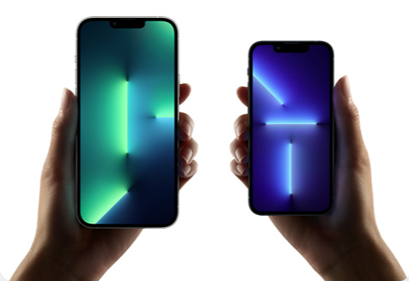
iPhone Market Segmentation
Laine
MKT 6971

Slide 2
Overview
Data
Driver Variables
Single
Factor
Clustering
Market Segments

Slide 3

Data
2015 National Consumer Survey
No filters applied for phone sales

Slide 4

Single Driver Variables
Phone Use & Priorities
I am more likely to switch cell phone service providers if they offer the latest in technology
My cell phone/ smartphone connects me to my social world
My cell phone/ smartphone is an expression of who I am
My cell phone/ smartphone should help me get work done when and where I want

Slide 5

Factor Variables: Career Focus
I am willing to sacrifice time with my family in order to get ahead
I want to get to the very top in my career
I am a workaholic
Money is the best measure of success

Slide 6

Factor Variables: Consumer Privacy
I like knowing how companies are using information about me
I want more personal control over information that companies might have about me
I often look up an organization online before providing my information
I would feel more comfortable providing personal information to companies that display a trusted seal of approval
I know many people who have had something negative happen to them because of personal information available online

Slide 7
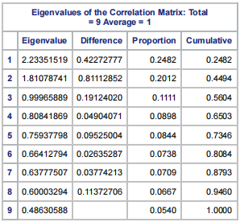
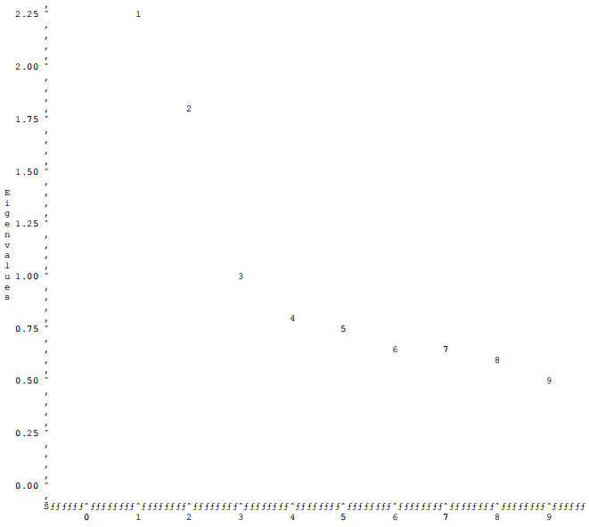
Factor Variable Creation SAS proc factor (varimax rotation)
Scree Plot

Slide 8
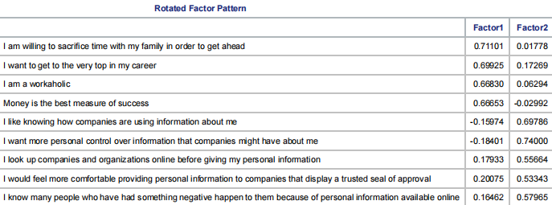
Factor Variable Creation SAS proc factor (varimax rotation)

Slide 9
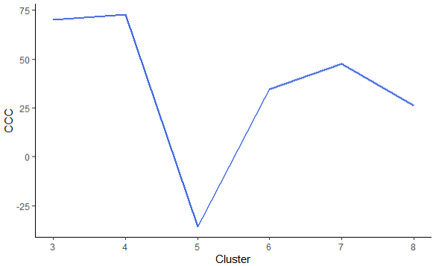
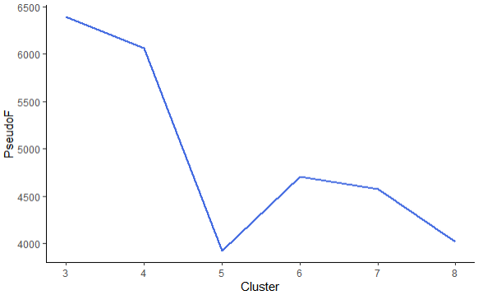
k-Means Clustering SAS proc fastclus
CCC Plot
Pseudo F Plot
First local maximum: 4
First local maximum: 6

Slide 10
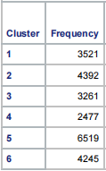
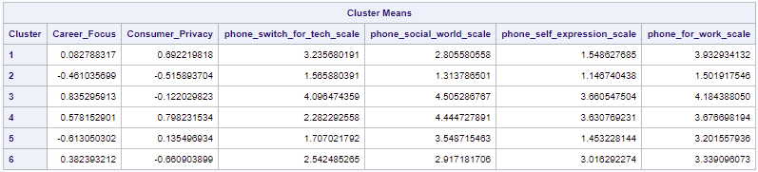
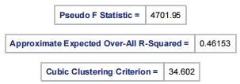
k-Means Clustering Solution

Slide 11
Market Segments
Brand Totals:

Slide 12
Market Segment Demographics

Slide 13

“Market Potential” Segments 1 & 5
Cluster 1
More likely to use Samsung phones
Low to middling scores for TV, radio and newspaper consumption
Less likely to respond to social media advertising and product placement
Low Career Focus score but second highest use of phones for work
Second highest concern with Consumer Privacy
Second highest concern with phone tech
Cluster 5
Most even distribution of phone brands
Even lower scores for TV, radio and newspaper consumption
Even lower scores for response to social media advertising and product placement
Low to middling scores across all descriptors
Highest score within cluster was 3.55 for phone use to connect to their social world

Slide 14

“Market Strength” Segments 3 & 4
Cluster 3
Highest percentage of iPhone users relative to competitors
High scores for TV and radio consumption
Most likely to respond to social media advertising and product placement
Highest scoring cluster for Career Focus and all single driver phone use variables
Low concern with Consumer Privacy (-0.12)
Cluster 4
Second highest percentage of iPhone users
High scores for TV and radio consumption
Similar scores to Cluster 3 across most descriptor and driver variables
Highest concern with Consumer Privacy (0.80)
Highest percentage of Samsung users
Highest percentage of female respondents (60%)
Highest percentage of Hispanic respondents (45%)
Second most likely to respond to social media advertising and product placement
Lower concern with phone tech and phone use for work

Slide 15

“Flip Phones” Segments 2 & 6
Cluster 2
Lowest percentage of iPhone and competitor users
High scores for TV and newspaper consumption
Least likely to respond to social media advertising and product placement
Very low scores across all phone use and driver variables
Cluster 6
Second lowest percentage of iPhone and competitor users
Low TV and radio consumption
Second least likely to respond to social media advertising and product placement
Low to middling scores across all phone use and driver variables
Second highest newspaper consumption

